Slide 1
Modernisation theory
02 Adapted from S Moore

Slide 2
Introduction to Modernisation theory
For a country to be seen as modern, modernisation theorists say it has to undergo an evolutionary advance in science and technology which in turn would lead to an increased standard of living for all

Slide 3
Causes of lack of development or progress towards modernisation?
That some countries have not modernised is seen to be the result of internal factors such as (a) poverty and (b) inadequate culture

Slide 4
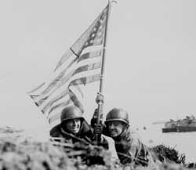
Historical background to modernisation theory
Post world war two’s deepening poverty in some countries
Ideological competition from communism

Slide 5
3 Increasing unrest in some countries
4 The above posed a threat to capitalism, and especially the USA
5 This led to the development of modernisation theory (mainly by US economists and policy makers)

Slide 6

Modernisation theorists aimed to:
explain why poorer countries failed to evolve into modern societies
Reduce the spread of communism by presenting capitalist values as the solution to poverty
Modernisation theory has become
increasingly influential, especially since post
collapse of USSR

Slide 7
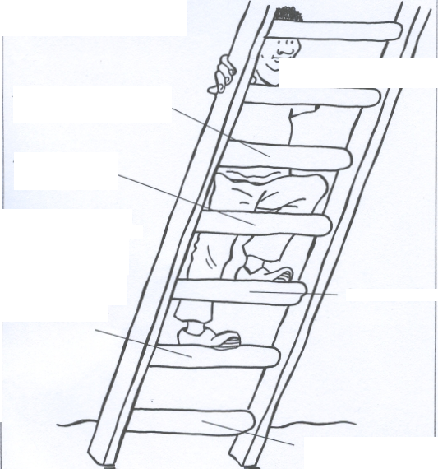
Rostow’s evolutionary ladder of development (economic factors)
5 The age of high Mass consumption
4 The drive to maturity: economic and cultural factors lead to increasing prosperity for all
2 Pre-conditions for take-off: the West assists development through aid and industrial investment
3 Take-off: high economic growth and investment in infrastructure begins
1 Traditional society: poverty, primary production and traditional values

Slide 8
Parson’s (cultural factors block development)
Traditional values block a country from developing e.g. valuing the extended family, blocks geographical mobility
Traditional values Modern values
Ascription Achievement
Particularism Universalism
Collectivism Individualism

Slide 9


Modernisation theory – role of the West in developing countries
Western investment in factories, expertise and equipment – use loans from World Bank (Trickle down)
Western funding to introduce meritocratic education (values of universalism, individualism and competition (Hoselitz)

Slide 10


Modernisation theory – the West and the developing countries (continued)
iii Mass media to disseminate modern ideas e.g. nuclear families
(Inkles)
iv Urbanisation to be encouraged (Hoselitz)

Slide 11
With such help from the west poor countries would develop
capitalist entrepreneurial middle class to develop business opportunities
High mass consumption
An urban population
Lifestyles of conspicuous consumption

Slide 12
Criticism of modernisation theory
It is ethnocentric because
(a) it devalues traditional values and social institutions e.g. extended families
(b) it ignores increasing inequality within and between countries
(c) it is not a neutral theory as it suggests (it promotes western capitalist values)

Slide 13
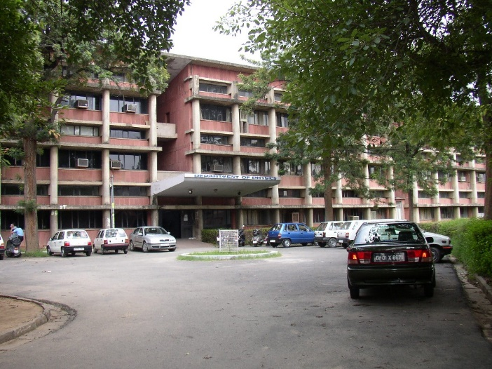
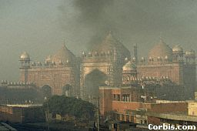
Education in developing world mainly benefits small, local elites (those at the top)
It assumes unlimited natural resources for industrial expansion. (ignores ecological issues)

Slide 14
  There is no, one single way to advancement and historical context is also important.
  The cultures of developing countries e.g the importance of the family, may be a response to economic insecurity and low levels of material well-being not the cause of it. (Inglehart and Baker 2000)

Slide 15
Influence of modernisation theory today
Paternalism of NGO’s – ‘people first’ policies are based on western ‘help’ as it is deemed that poor countries cannot help themselves
Neo-liberals want a free market and advocate ‘helping’ poor countries. (Arguably they want it both ways depending on what suits them.)

Slide 16
Neo modernisation theorists stress importance of cultural values
Huntington argues there are eight cultural zones
Christian traditions and values led to economic prosperity for the Western zone
Non western zones resent this prosperity

Slide 17
Some may respond by rejecting modernisation and return to fundamentalism Eg the Arab World and fostering of international terrorism (Sept 11th)
Marxists say it is not cultural but economic factors which matter most, and western ideas about modernisation are laden with capitalist values

